Slide 1
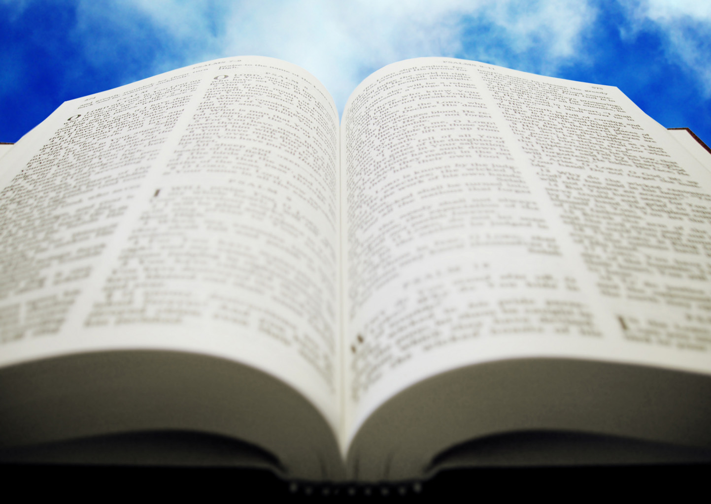
Welcome!
Sunday
Worship 10:00 AM
Sunday
Bible Class (Livestream) 5:00 PM
Wednesday
Bible Class 7:00 PM
www.SunsetchurchofChrist.net

Slide 2
Opening Prayer | Lamar McDonald
Song – | Craig Foster
Song – | Craig Foster
Lord’s Supper | Michael Hetzer
Song – | Craig Foster
Song – | Craig Foster
Lesson | Brian Haines
Song – | Craig Foster
Closing | Rob Wade
1 Corinthians 16:2
On the first day of the week let each one of you lay something aside, storing up as he may prosper, that there be no collections when I come.
A collection basket
is in the foyer

Slide 3
The Resurrection
1 Corinthians 15:17
And if Christ is not risen, your faith is futile; you are still in your sins!
Notes:
1 Cpoer

Slide 4
Paul’s Observation
1 Corinthians 15:12-20
- Our hope is based on Jesus’ resurrection
- Without it we are the most pitiable

Slide 5
Luke 1:1-2
1. The historical truth in the accounts
- Citing people and places
- Citing dates and events
- Unified witness of events
The Gospels bear out as historically true
Notes:
Lu 1:1 ¶ Inasmuch as many have taken in hand to set in order a narrative of those things which have been fulfilled among us,
2 just as those who from the beginning were eyewitnesses and ministers of the word delivered them to us,

Slide 6
Galatians 1:13-14
2. The Apostle Paul
- Not a witness of the event
- An ardent anti-Christian
- Rejects everything for Christ
Paul is the ultimate hostile witness
Notes:
Ga 1:13 For you have heard of my former conduct in Judaism, how I persecuted the church of God beyond measure and tried to destroy it.
Ac 8:3; 9:1; 22:4; 26:11; 1Ti 1:13
14 And I advanced in Judaism beyond many of my contemporaries in my own nation, being more exceedingly zealous for the traditions of my fathers.
Jer 9:14; Mt 15:2; Mr 7:5; Ac 22:3; 26:9; P

Slide 7
Matthew 28:11-13
3. The Empty Tomb
- A critical point of Christianity
- Jewish and Roman leaders involved
- NOT ONCE denied by anyone!
The empty tomb is an undeniable truth
Notes:
Mt 28:11 ¶ Now while they were going, behold, some of the guard came into the city and reported to the chief priests all the things that had happened.
12 When they had assembled with the elders and consulted together, they gave a large sum of money to the soldiers, 13 saying, "Tell them, 'His disciples came at night and stole Him away while we slept.‘
They never produced a body
There was no veneration of the tomb

Slide 8
2 Timothy 3:14-15
4. The Devotion of the Apostles
- Writings by men well versed
- Clearly strong Mosaic foundations
- A new false religion is unimaginable
Mosaic devotion means validity
Notes:
2Ti 3:14 But you must continue in the things which you have learned and been assured of, knowing from whom you have learned them, 15 and that from childhood you have known the Holy Scriptures, which are able to make you wise for salvation through faith which is in Christ Jesus.

Slide 9
Luke 24:1-11
5. The Testimony of the Women
- Writings by men well versed
- Clearly strong Mosaic foundations
- A new false religion is unimaginable
Unique witnesses dismiss fabrication
Notes:
Lu 24:1 ¶ Now on the first day of the week, very early in the morning, they, and certain other women with them, came to the tomb bringing the spices which they had prepared.
Lu 24:11 And their words seemed to them like idle tales, and they did not believe them.

Slide 10
Luke 24:18
6. Testimony Outside the Scriptures
- Josephus
- Absence of Roman denial
- Absence of fallen believer’s denial
Opportunities to deny it are never taken
Notes:
Lu 24:18 Then the one whose name was Cleopas answered and said to Him, "Are You the only stranger in Jerusalem, and have You not known the things which happened there in these days?"

Slide 11
1 John 3:2
7. The Foreign Concept of Resurrection
- Many believed in resurrection
- No one believed in changed body
- Evidenced in not knowing Him
The resurrected body was something new
Notes:
1Jo 3:2 Beloved, now we are children of God; and it has not yet been revealed what we shall be, but we know that when He is revealed, we shall be like Him, for we shall see Him as He i

Slide 12
1 John 1:1-2
8. The Conviction of the Disciples
- Totally vested in the resurrection
- Prepared to die for it
- Prepared to live for it
Jesus’ disciples believed what they saw
Notes:
1Jo 1:1 ¶ That which was from the beginning, which we have heard, which we have seen with our eyes, which we have looked upon, and our hands have handled, concerning the Word of life-- 2 the life was manifested, and we have seen, and bear witness, and declare to you that eternal life which was with the Father and was manifested to us--

Slide 13
Mark 16:11
9. The Lack of Conviction of the Disciples
- At first they did not believe
- Only Jesus’ enemies remembered
- Took some time for them to believe
Jesus’ disciples reasonably doubted
Notes:
Mr 16:11 And when they heard that He was alive and had been seen by her, they did not believe.

Slide 14
1 Corinthians 15:8
10. The Multitude of Witnesses
- Over 500 people saw Jesus alive
- The explosion of Christianity
- Prepared to live for it
Christianity came from someone
Notes:
1Co 15:5 and that He was seen by Cephas, then by the twelve. 6 After that He was seen by over five hundred brethren at once, of whom the greater part remain to the present, but some have fallen asleep. 7 After that He was seen by James, then by all the apostles. 1Co 15:8 Then last of all He was seen by me also, as by one born out of due time.

Slide 15
What the Resurrection Proves
1. That the God of the Bible is Real
- That the Bible is true
- That the God of the Bible is real
- That everything in the Bible is true

Slide 16
What the Resurrection Proves
2. That Jesus was God in the Flesh
- That God died on the Cross
- That God overcame death
- That God’s love is unimaginable

Slide 17
What the Resurrection Proves
3. That there is life after death
- That there is a judgment
- That God means everything He says
- That we can choose to be with Him

Slide 18
But now Christ is risen from the dead, and has become the firstfruits of those who have fallen asleep. For since by man came death, by Man also came the resurrection of the dead. For as in Adam all die, even so in Christ all shall be made alive. But each one in his own order: Christ the firstfruits, afterward those who are Christ's at His coming. Then comes the end, when He delivers the kingdom to God 1 Corinthians 15:20-24a

Slide 20
"For God so loved the world that He gave His only begotten Son, that whoever believes in Him should not perish but have everlasting life.” John 3:16

Slide 21
The Love of God
"If you love Me, keep My commandments” John 14:15
“If anyone loves Me, he will keep My word” John 14:23

Slide 22
Jesus Said:
"Most assuredly, I say to you, he who hears My word and believes in Him who sent Me has everlasting life” John 5:24

Slide 23
Jesus Said:
"Therefore whoever confesses Me before men, him I will also confess before My Father who is in heaven.” Matthew 10:32

Slide 24
Jesus Said:
From that time Jesus began to preach and to say, "Repent, for the kingdom of heaven is at hand." Matthew 4:17

Slide 25
Jesus Said:
And He said to them……."He who believes and is baptized will be saved; but he who does not believe will be condemned.” Mark 16:15,16

